Slide 1
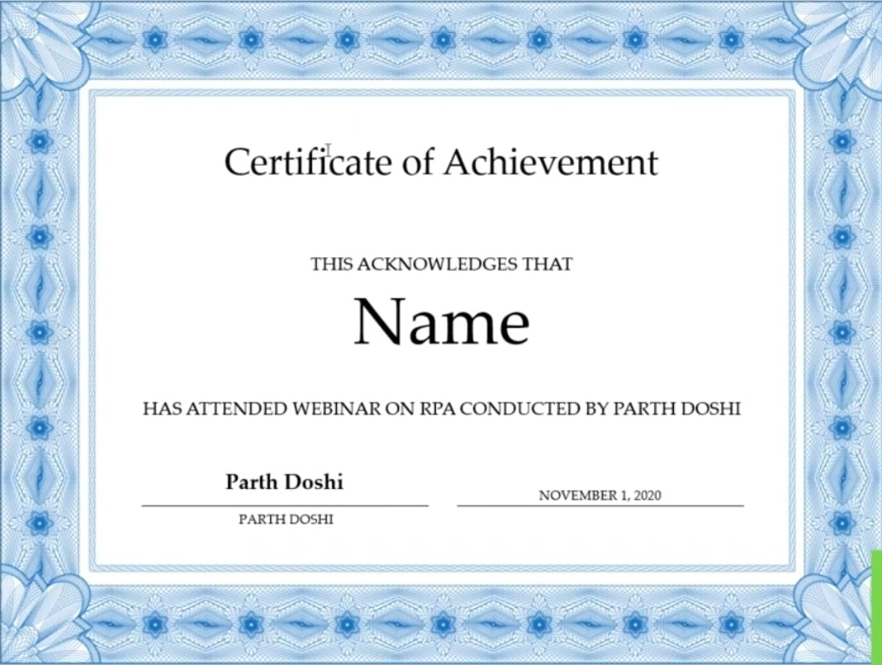
Certificate of Participation
THIS ACKNOWLEDGES THAT
Deepa S Nashipudi
HAS PARTICIPATED IN Hackthon CONDUCTED BY
AGMR | BRANCH: CSE
MRS. KAVITHA
SEPTEMBER 28,2026

